Slide 1
Energy and the Built Environment CRP 470.004 /570.004
Christian E. Casillas
Lecture 12
Energy Policy

Slide 2
Remaining Classes
April 15: Climate and energy policy tools
April 22: Examples of energy and planning
April 29: Activity tying concepts together
May 6: Project Presentations

Slide 3
Outline
Wedges
Low carbon policy/planning tools
Class projects

Slide 4
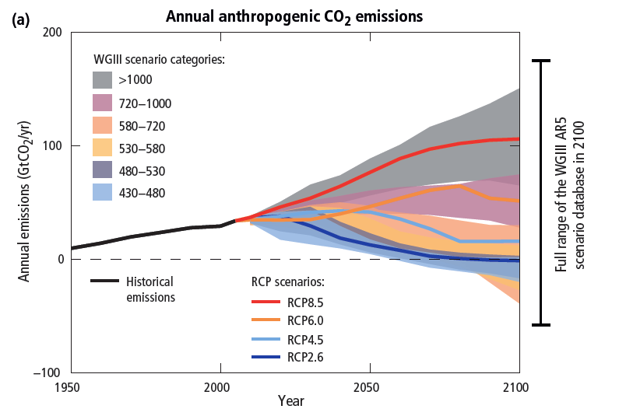
Source: IPCC, Summary for Policy Makers, AR5 2014

Slide 5
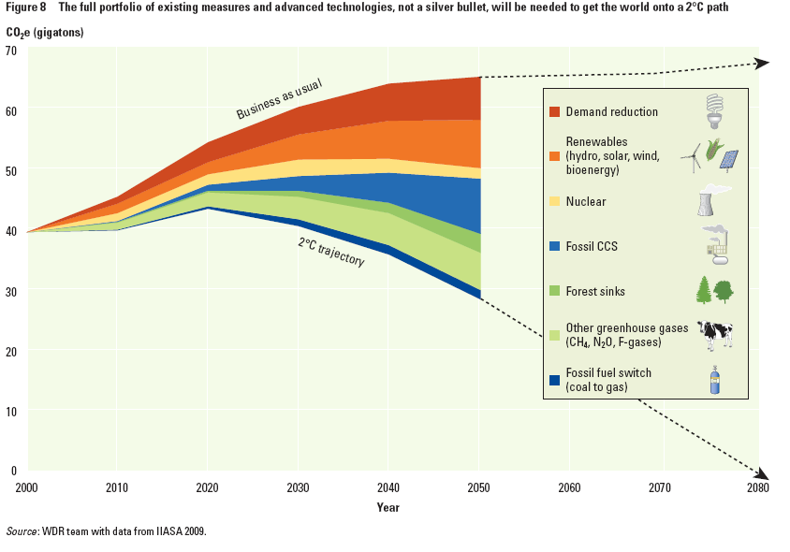
Source: World Development Report 2010

Slide 6
Wedges…
Source: Pacala and Socalow. 2004.

Slide 7
Example
1 Gt C/yr
50 years
½ x 50 yrs x 1 Gt C/yr = 25 Gt C emissions avoided

Slide 8
Example: car mpg efficiency
2010: 1 billion cars, 2060: 4 billion cars
With fuel efficiency of 25 mpg, driving 11,000 miles/yr, emissions are about 1 t of C/yr
What if efficiency increases to 50 mpg (CAFE) by 2060?
4 Gt C/yr
75 Gt C
1 Gt C/yr
2010
2060

Slide 9
Example: car mpg efficiency
2010: 1 billion cars, 2060: 4 billion cars
With fuel efficiency of 50 mpg in 2060, driving 11,300 mi/yr, emissions are about 2.1 t of C/yr
4 Gt C/yr
50 Gt C
2 Gt C/yr
25 Gt C
1 Gt C/yr
2010
2060

Slide 10
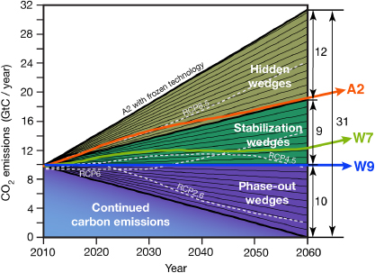
475 GtC
Reduction
Source: Steven J Davis et al (2013). Rethinking Wedges. Environ. Res. Lett. 8

Slide 11
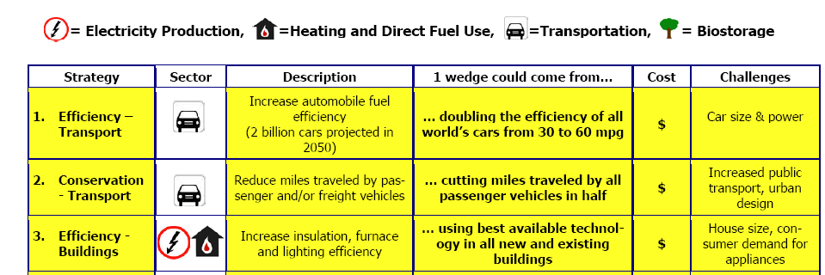
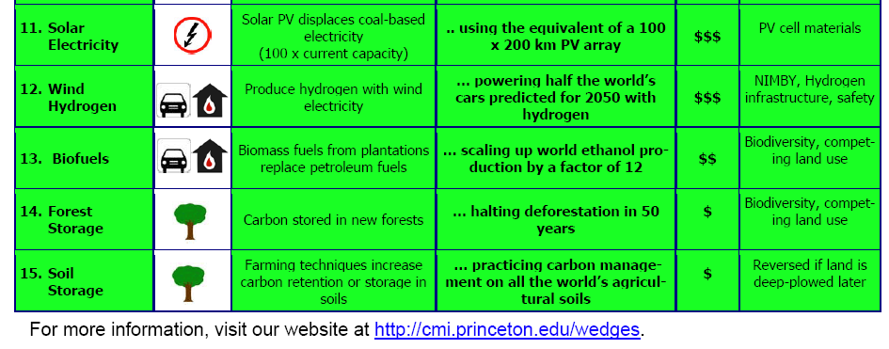

Slide 12
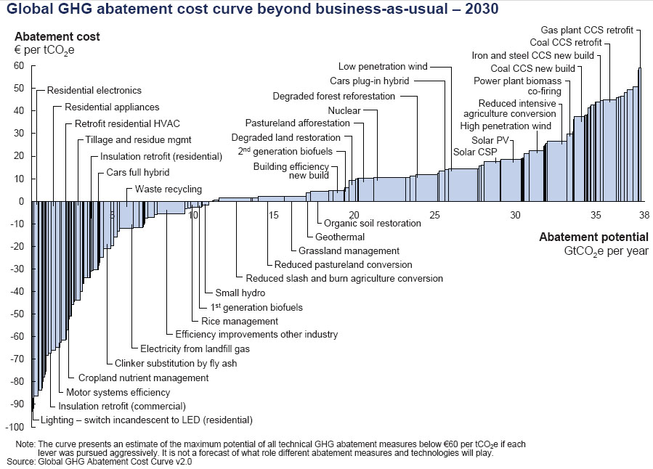
Marginal Abatement Cost (MAC) Curve
Source: McKinsey & Co, 2008

Slide 13
Wedges and MAC Curves….

Slide 14
How Do We Get There?
Market Transformation
Techno-economic solutions
Policy solutions
Social solutions

Slide 15
Techno-economic solutions
Energy Efficiency
Renewable Energy
Economic Levers

Slide 16
Technology solutions….

Slide 17
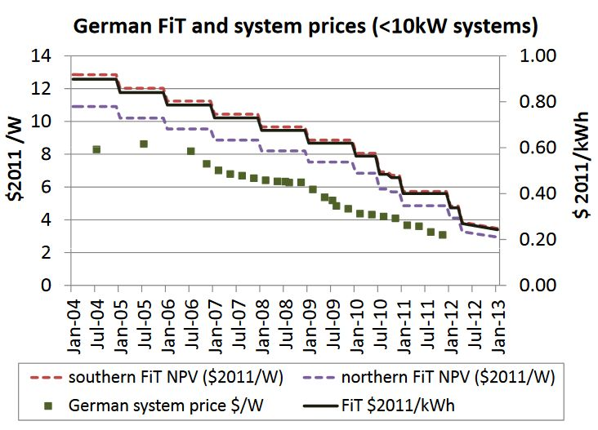
Feed-In Tariffs (FITs)

Slide 18
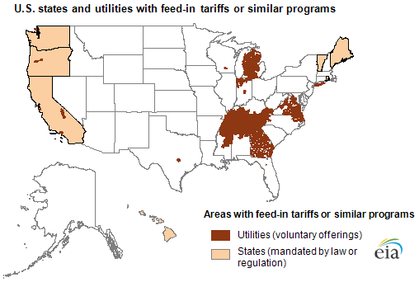
Feed-in Tariffs - FIT
Example: Virginia State Corporation Commission allows participants to receive 15 cents/kWh for a term of five years for all PV-generated electricity provided to the grid, and will continue to pay the retail rate for all electricity that they consume. Virginia's average 2012 retail electricity price was 10.5 cents/kWh for residential customers and 7.8 cents/kWh for commercial customers.

Slide 19
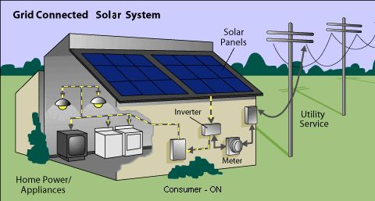
Net Metering

Slide 20
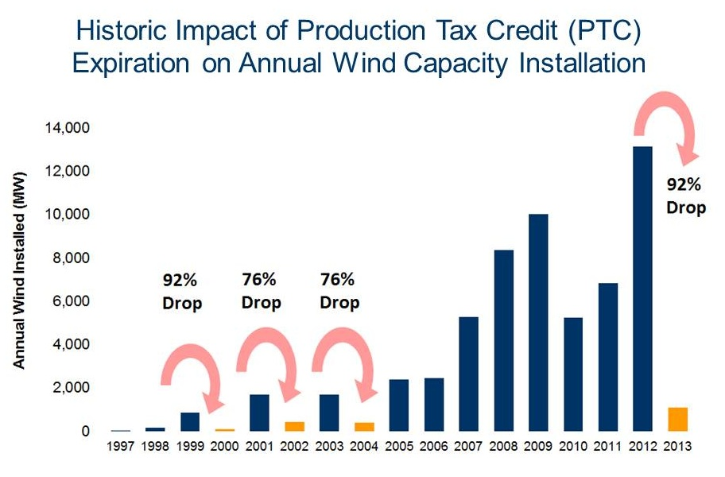
Corporate Production Tax Credit (PTC)
2.3¢/kWh for wind, geothermal, closed-loop biomass; 1.1¢/kWh for other eligible technologies. Generally applies to first 10 years of operation

Slide 21
Policy Solutions
Renewable Portfolio Standards (RPS)

Slide 22
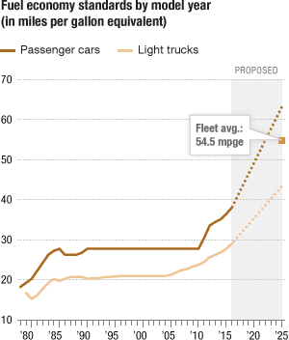
CAFE Standards

Slide 23
Energy efficiency standards
www.dsireusa.org / March 2015
DC
26 States
Have Statewide Energy Efficiency Resource Standards (or Goals)
U.S. Territories
PR
Guam
USVI
NMI
States with an Energy Efficiency Resource Standard
States with an Energy Efficiency Resource Goal
No State Standard or Goal

Slide 24
Renewable Portfolio Standard Policies
www.dsireusa.org / March 2015
WA: 15% x 2020*
ME: 40% x 2017
ND: 10% x 2015
NH: 24.8 x 2025
MT: 15% x 2015
MN:26.5%
x 2025 (IOUs)
31.5% x 2020 (Xcel)
VT: 20% x 2017
OR: 25%x 2025*
(large utilities)
MA: 15% x 2020(new resources)
6.03% x 2016 (existing resources)
SD: 10% x 2015
WI: 10% 2015
MI: 10% x 2015*†
NY: 29% x 2015
RI: 14.5% x 2019
IA: 105 MW
CT: 27% x 2020
IN: 10% x 2025†
OH: 12.5% x 2026
NJ: 20.38% RE x 2020
+ 4.1% solar by 2027
NV: 25% x
2025*
UT: 20% x 2025*†
IL: 25% x 2026
CO: 30% by 2020 (IOUs) *†
VA: 15% x 2025†
PA: 18% x 2021†
CA: 33%
x 2020
KS: 20% x 2020
MO:15% x 2021
DC
DE: 25% x 2026*
NC: 12.5% x 2021 (IOUs)
MD: 20% x 2022
NM: 20%x 2020 (IOUs)
OK: 15% x 2015
DC: 20% x 2020
AZ: 15% x 2025*
SC: 2% 2021
TX: 5,880 MW x 2015*
29 States + Washington DC + 2 territories have a Renewable Portfolio Standard
(8 states and 2 territories have renewable portfolio goals)
U.S. Territories
HI: 40% x 2030
NMI: 20% x 2016
Guam: 25% x 2035
PR: 20% x 2035
USVI: 30% x 2025
*
Renewable portfolio standard
Extra credit for solar or customer-sited renewables
Renewable portfolio goal
†
Includes non-renewable alternative resources

Slide 25
Low Income Home Energy Assistance Program (LIHEAP)
Offers assistance with: Energy crises, Bill payment assistance, and weatherization and energy-related home repairs

Slide 26
Social Solutions
Renewable Portfolio Standards (RPS)

Slide 27
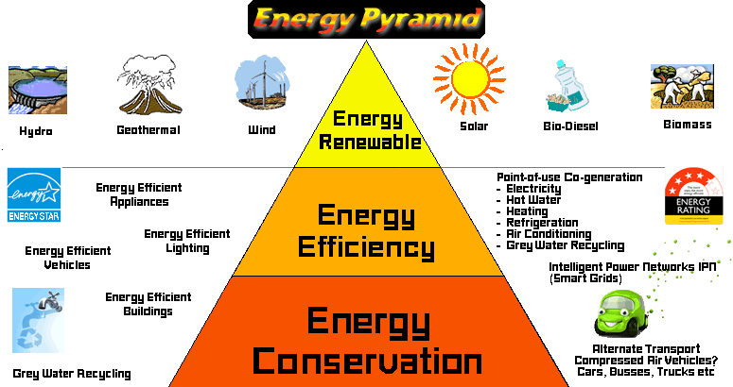

Slide 28
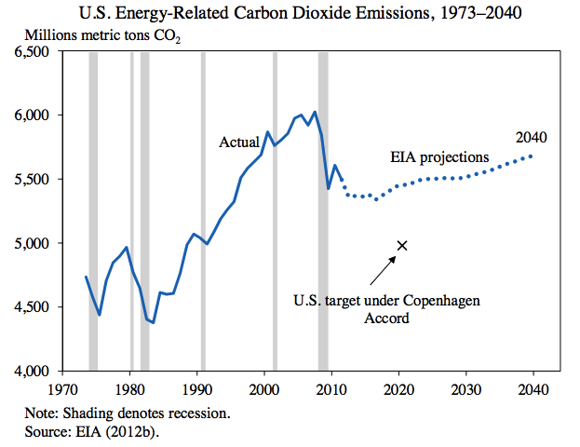
Obama’s pledge…

Slide 29
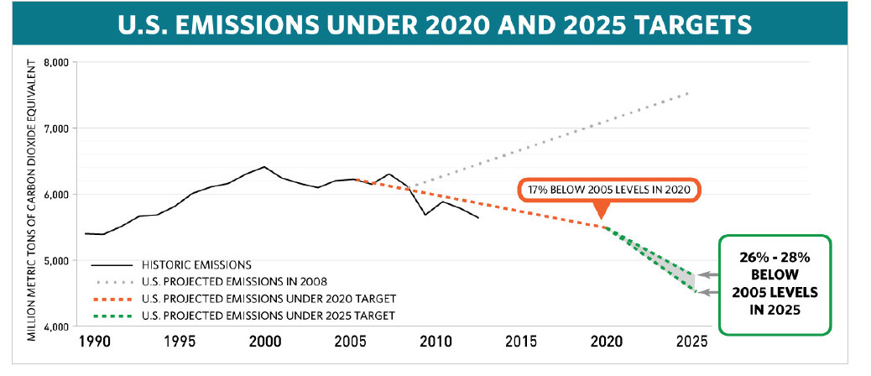
Document submitted to UN

Slide 30
Document submitted to UN
25 Gt CO2 eq
7 Gt C
10 near-term wedges (15 yrs) of 2.5 Gt CO2 eq
0.3 Gt CO2/yr
15 yrs

Slide 31
What about over 50 yrs?
220 Gt CO2 eq
9 Gt CO2/yr
25 Gt CO2 eq
3 Gt CO2/yr
17 yrs
50 yrs

Slide 32
Mitigation sources (McKinsey)

Slide 33
What would a wedge of solar look like ?
US household consumption: 12,000 kWh/yr
Emission/kWh (ave factor for US grid, 2010): 0.68 kg CO2/kWh or (0.27 x ) 0.18 kg C/kWh
12,000 kWh/yr x 0.68 kg CO2/kWh = 8.2 tCO2/yr per household avoided
In 2014 there were 123 million US households, how many would need to switch to solar to save 0.33 Gt CO2/yr?
0.33e9 t CO2/yr / 8.2 t CO2/yr = 41,000,000 hh (33% of 2014 hh)

Slide 34
Estimating PV production
All PV modules are rated at Standard Test Conditions (STC) : irradiance of 1 kW/m², solar spectrum of AM 1.5 and module temperature at 25°C.
So a 100 W panel produces 100 W per 1 kW/m² of solar radiation
Solar resources are typically reported in units of kWh/m²/day
(perpendicular to a flat surface)
Maximum radiation falls on a flat, fixed surface, when it is at an tilt angle equal to the latitute (35 degrees for Abq)

Slide 35
Example of solar calc
What would daily production be for a 2 kW solar array installed in a resource of 5 kWh/m²/day?
Where a solar resource of 1 kWh/m^2/day is called 1 sun hour (it is 1 hour of sun at standard test conditions)

Slide 36
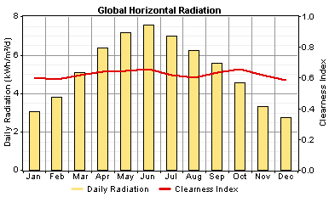
Modeled radiation for ABQ

Slide 37
Example of solar calc
How much daily energy would 1kW of installed solar generate in June? In January?
1 kW x 7.5 hrs = 7.5 kWh/day in June
1kW x 3 hrs = 3 kWh/day in Jan
Ave is 5.2 sun hours per day

Slide 38
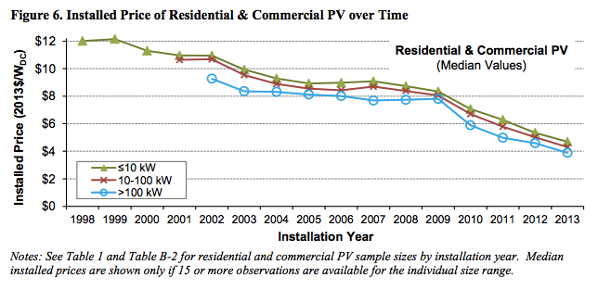
Installation Costs
Source: LBNL, Tracking the Sun

Slide 39
Financial Payback
30% federal tax credit
10% state tax credit
PACE – payment added to mortgage

